Slide 1

Lecture 14
Styling in the Presentation Layer: Cascading Style Sheets (CSS)

Slide 2
Separating Out Presentation
HTML is used to specify the structure of the information shown in a Web page.
It is recommended that the style (colors, font sizes etc.) is specified by using Cascading Style Sheets (CSS), separate from the structure.
Appearance of a Web site is not only an issue for graphic designers, but also a management problem:
We need to maintain a consistent style across the Web site, while introducing differences between various areas in a controlled manner.
At the same time, it should be possible to change the appearance in a consistent way without re-implementing the Web site.

Slide 3
Style Sheets
Style sheets allow the separation of style from structure.
Styles can be applied in-line, internally to a document or externally
  Across a whole web site, a single page, or to a specific element
Multiple styles can be cascaded together

Slide 4
Inline Styles
The simplest way to use CSS is with inline styles.
  Using the ‘style’ attribute.
In this case, style=“color: blue" is the CSS.
Browsers support standard attribute names for at least the following 16 colors :
  aqua, black, blue, fuchsia, gray, green, lime, maroon, navy, olive, purple, red, silver, teal, white, yellow.
Most browsers support a large number of other standard color names
<h1 style="color: blue">Heading</h1>

Slide 5
Color Styles
You can ‘mix’ your own colors using RGB (Red, Green, Blue) values in this format:
  color: rgb(r,g,b)
  The value of each color is in the range 0-255
  You can also set the background color
  Multiple properties are separated by semicolons
<h2 style="color: rgb(255,255,255)”>…</h2>
<h2 style="color: white; background-color: black">Sub heading</h2>

Slide 6
Internal Style Sheets
Adding styles only to individual tags is not very flexible
Styles become more useful when they are applied to a whole document using Style Sheets and adding a STYLE element to the HEAD
For example we could use a style sheet to make all the main headings in the document blue and centered (text-align property)
<style type="text/css">
h1 {color: blue; text-align: center}
</stype>

Slide 7
Grouping Styles
A single style can be applied to more than one element type
Multiple tag names can be put into a comma separated list
<style type="text/css">
h1,h2
{
color: blue;
text-align: center
}
</style>

Slide 8
Applying Multiple Styles
A single style element can be used to specify multiple styles across the whole document
<style type="text/css">
h1{color: blue; text-align: center}
h2{color: red; font-style: italic}
p{font-family: sans-serif}
</style>

Slide 9
External Style Sheets
We can also specify a stylesheet in a separate document
A file with a ‘.css’ extension
No ‘style’ tag is used in the file
h1{color: blue; text-align: center}
h2{color: red; font-style: italic}
p{font-family: sans-serif}
webhomecover.css

Slide 10
Conflict Resolution
In case of conflicts, styles defined in informationpage.css (the second in the list) will override styles defined in webhomecover.css
Styles defined under the STYLE element will override any styles defined externally.
Styles defined inline will override all the rest.

Slide 11
Styles with class and id Attributes
So far we have applied styles to HTML elements
We can use the ‘class’ and ‘id’ attributes to apply the same style to more than one type of HTML element
and/or
  Apply a style to some, but not all, instances of a particular HTML element.
and/or
  Apply a style to one specific instance of an element
The class attribute assigns a shared identifier to a set of elements.
The id attribute assigns a unique identifier to an element.

Slide 12
Element class Attributes
The class attribute assigns one or more class names to an element; the element may be said to belong to these classes.
A class name may be shared by several element instances.
We can apply styles to this class is a stylesheet, using the name of the class preceded by a period:
<h1 class="heading">We provide the following types of insurance</h1>
<h2 class="heading">Buildings Cover</h2>
.heading{text-align: center}

Slide 13
Selecting Elements by Class
It is also possible to apply a style to a subset of HTML elements
  Here, we apply a style to paragraphs of class ‘emphasis’
  Only paragraph elements in the ‘emphasis’ class will have this style applied
  Other paragraphs, or non-paragraph elements of the emphasis class, are unaffected
p.emphasis{font-weight: bold}

Slide 14
Element id Attributes
In this example, the id attribute is used to uniquely identify some footer content
  Since an id is unique, the ‘footer’ style will only apply to this element.
In the style sheet, styles applied to elements with ids are preceded by the # symbol
<p id="footer">&copy;WebHomeCover.com 2008</p>
#footer {
font-weight:bold; font-style:italic; color:white;
background-color:black; text-align:center
}

Slide 15
What About Backgrounds?
The background-color property specifies the background color of an element.
The background color of a page is defined in the body selector:
<STYLE type="text/css">
  body {background-color:#b0c4de;}
</STYLE>

Slide 16
What About Backgrounds?
In the example below, the h1, p, and div elements have different background colors:x
h1 {background-color:#6495ed;}
p {background-color:#e0ffff;}
div {background-color:#b0c4de;}

Slide 17
What About Backgrounds?
The background-image property specifies an image to use as the background of an element.
By default, the image is repeated so it covers the entire element.
body {background-image:url(‘rocks.jpg’);}

Slide 18
What About Backgrounds?
By default, the background-image property repeats an image both horizontally and vertically.
The image can be repeated only horizontally (repeat-x), for example :
body
{
background-image:url(‘stones.png');
background-repeat:repeat-x;
}

Slide 19
What About Backgrounds?
Showing the image only once is specified by the background-repeat property:
body
{
background-image:url('trees.png');
background-repeat:no-repeat;
}

Slide 20
What About Backgrounds?
Sometimes we want to position the image
  demo
body
{
background-image:url('img_tree.jpg');
background-repeat:no-repeat;
background-position:right top;
margin-right:200px;
}

Slide 21
What About Backgrounds?
As you can see from the examples above, there are many properties to consider when dealing with backgrounds.
To shorten the code, it is also possible to specify all the properties in one single property. This is called a shorthand property.
The shorthand property for background is simply "background":
body {background:#ffffff url('img_tree.png') no-repeat right top;}

Slide 22
What About Backgrounds?
As you can see from the examples above, there are many properties to consider when dealing with backgrounds.
To shorten the code, it is also possible to specify all the properties in one single property. This is called a shorthand property.
The shorthand property for background is simply "background":
body {background:#ffffff url('img_tree.png') no-repeat right top;}

Slide 23
Text Formatting Styles
Font style
Font weight
Font family
font-style: italic
font-weight: bold
font-family: sans-serif

Slide 24
Text Formatting Styles
The text-align property is used to set the horizontal alignment of a text.
Text can be centered, or aligned to the left or right, or justified.
When text-align is set to "justify", each line is stretched so that every line has equal width, and the left and right margins are straight (like in magazines and newspapers).
h1 {text-align:center;}
p.date {text-align:right;}
p.main {text-align:justify;}

Slide 25
Text Formatting Styles
The text-decoration property is used to set or remove decorations from text.
The text-decoration property is mostly used to remove underlines from links for design purposes:
It can also be used to decorate text:
a {text-decoration:none;}
h1 {text-decoration:overline;}
h2 {text-decoration:line-through;}
h3 {text-decoration:underline;}

Slide 26
Text Formatting Styles
The text-transform property is used to specify uppercase and lowercase letters in a text.
It can be used to turn everything into uppercase or lowercase letters, or capitalize the first letter of each word.
p.uppercase {text-transform:uppercase;}
p.lowercase {text-transform:lowercase;}
p.capitalize {text-transform:capitalize;}

Slide 27
Text Formatting Styles
The text-indentation property is used to specify the indentation of the first line of a text.
p {text-indent:50px;}

Slide 28
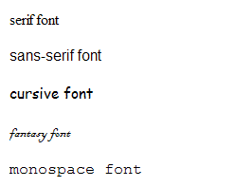
Font Families
Five generic font families
  serif
  sans-serif
  cursive
  fantasy
  Monospace
Browser will map to a specific font that it supports

Slide 29
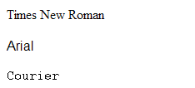
Specific Families
The generic font families can vary in their mapping to specific fonts by browsers
Choosing a commonly supported font can be more predictable, e.g.
  Times New Roman
  Arial
  Courier
Font names with spaces need to be in quotes
<P style="font-family: 'Times New Roman'">Times New Roman</P>

Slide 30
Font Styles
The font-style property is mostly used to specify italic text.
This property has three values:
  normal - The text is shown normally
  italic - The text is shown in italics
  oblique - The text is "leaning" (oblique is very similar to italic, but less supported)
p.normal {font-style:normal;}
p.italic {font-style:italic;}
p.oblique {font-style:oblique;}

Slide 31
Font Sizes
The font-size property sets the size of the text.
Being able to manage the text size is important in web design.
However, you should not use font size adjustments to make paragraphs look like headings, or headings look like paragraphs.
Always use the proper HTML tags, like <h1> - <h6> for headings and <p> for paragraphs.

Slide 32
Font Sizes
The font-size value can be an absolute, or relative size.
Absolute size:
  Sets the text to a specified size
  Does not allow a user to change the text size in all browsers (bad for accessibility reasons)
  Absolute size is useful when the physical size of the output is known
Relative size:
  Sets the size relative to surrounding elements
  Allows a user to change the text size in browsers

Slide 33
Font Sizes
Setting the text size with pixels gives you full control over the text size:
h1 {font-size:40px;}
h2 {font-size:30px;}
p {font-size:14px;}

Slide 34
Font Sizes
To avoid the resizing problem with older versions of Internet Explorer, many developers use em instead of pixels.
The em size unit is recommended by the W3C.
1em is equal to the current font size. The default text size in browsers is 16px. So, the default size of 1em is 16px.
The size can be calculated from pixels to em using this formula: pixels/16=em
h1 {font-size:2.5em;} /* 40px/16=2.5em */
h2 {font-size:1.875em;} /* 30px/16=1.875em */
p {font-size:0.875em;} /* 14px/16=0.875em */

Slide 35
Font Sizes
In the example above, the text size in em is the same as the previous example in pixels. However, with the em size, it is possible to adjust the text size in all browsers.
Unfortunately, there is still a problem with older versions of IE. The text becomes larger than it should when made larger, and smaller than it should when made smaller.
So…

Slide 36
Font Sizes
The solution that works in all browsers, is to set a default font-size in percent for the <body> element:
Now that shows the same text size in all browsers, and allows all browsers to zoom or resize the text!
body {font-size:100%;}
h1 {font-size:2.5em;}
h2 {font-size:1.875em;}
p {font-size:0.875em;}

Slide 37
List Styles
Lists can be styled using the list-style-type property
  Unordered lists can use ‘disc’, circle’ or ‘square’
  Ordered lists have several options….
list-style-type attribute | Numbering style
decimal | (1,2,3,…) – the default
upper-alpha | (A,B,C…)
lower-alpha | (a,b,c…)
upper-roman | (I,II,III,IV…)
lower-roman | (i,ii,iii,iv…)
ul{list-style-type: square}
ol{list-style-type: lower-roman}

Slide 38
List Styles
To specify an image as the list item marker, use the list-style-image property:
The example above does not display equally in all browsers. IE and Opera will display the image-marker a little bit higher than Firefox, Chrome, and Safari. (Try it!)
ul
{
list-style-image: url(‘item.gif');
}

Slide 39
List Styles
The following example displays the image-marker equally in all browsers:
ul
{
ist-style-type: none;
padding: 0px;
margin: 0px;
}
ul li
{
background-image: url(sqpurple.gif);
background-repeat: no-repeat;
background-position: 0px 5px;
padding-left: 14px;
}

Slide 40
List Styles
It is also possible to specify all the list properties in one, single property. This is called a shorthand property.
The shorthand property used for lists, is the list-style property:
ul
{
list-style: square url(“item.gif");
}

Slide 41
Style Sheet Cascades
CSS allows style information from several sources to be blended together.
<link href="webhomecover.css" rel="stylesheet" type="text/css">
<link href="informationpage.css" rel="stylesheet" type="text/css">
<style type="text/css">
p.important {color: red; font-size: large}
</style>
<h2 class=“heading“ style=“font-style: normal>

Slide 42
Block and Inline Elements
DIV (division) specifies block level elements
  Separated from other blocks, though may be nested within them
SPAN specifies
inline elements
  Part of a block,
  or another span
block
in-line
in-line
block
in-line
in-line
in-line

Slide 43
DIV and SPAN Elements
DIV and SPAN elements can be used to apply styles
These elements have little effect on the presentation, but can act as placeholders for styles
<div class="heading bigger">Buildings Insurance</div>
<div class="text">
..
<span id="risk">severe damage to your home</span>
.heading {text-align: center; color: blue; font-size: large}
.text {text-align: left; color: black}
.bigger {font-size: 2em}
#risk {font-weight: bold; font-style: italic; color: red}

Slide 44
The CSS Box Model
All HTML elements can be considered as boxes.
In CSS, the term "box model" is used when talking about design and layout.
The CSS box model is essentially a box that wraps around HTML elements, and it consists of: margins, borders, padding, and the actual content.
The box model allows us to place a border around elements and space elements in relation to other elements.

Slide 45
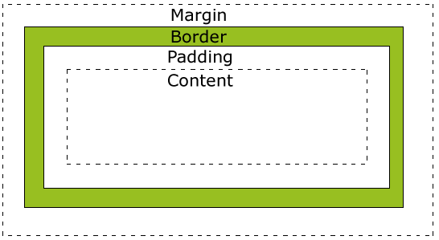
The CSS Box Model
The image below illustrates the box model:

Slide 46
Width and Height
When you set the width and height properties of an element with CSS, you just set the width and height of the content area.
To calculate the full size of an element, you must also add the padding, borders and margins.

Slide 47
Width and Height
The total width of the element in the example below is 300px:
width:250px;
padding:10px;
border:5px solid gray;
margin:10px;
250px (width) + 20px (left + right padding)
+ 10px (left + right border)
+ 20px (left + right margin) = 300px

Slide 48
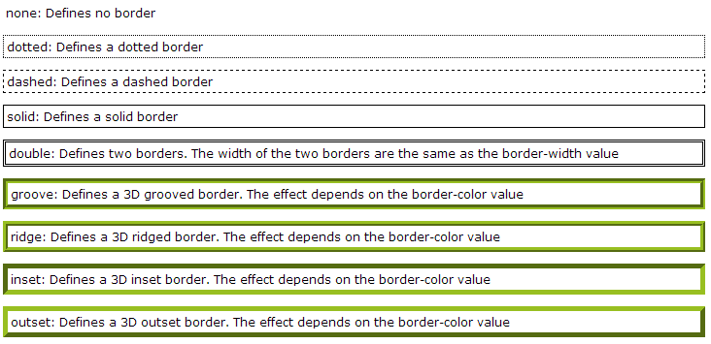
Borders
The border-style property specifies what kind of border to display.

Slide 49
Borders
The border-width property is used to set the width of the border.
The width is set in pixels, or by using one of the three pre-defined values: thin, medium, or thick.
p.one
{
border-style:solid;
border-width:5px;
}
p.two
{
border-style:solid;
border-width:medium;
}

Slide 50
Borders
In CSS it is possible to specify different borders for different sides:
p
{
border-top-style:dotted;
border-right-style:solid;
border-bottom-style:dotted;
border-left-style:solid;
}

Slide 51
Using CSS for Page Layout
Some CSS styles can be used to manage page layout
float (left or right)
  Positions the element on the page and allows other elements to wrap around it
clear (left or right)
  Prevents this element from wrapping around other elements
Setting element widths and margins is also useful here

Slide 52
CSS Styles for 3-Region Layout
A combination of float, clear and margin can help us to lay out a page using styles rather than tables
#navigationbar {clear: both}
#sidenavigation {float: left; width: 10em}
#content {margin-left: 10em}
#pagefooter {clear: both}

Slide 53
Using CSS with Anchors
An anchor can be in one or four states
  Link - a link that has not been clicked on and the mouse pointer is not hovering over it
  Visited - a link that has previously been visited and the mouse pointer is not hovering over it
  Hover - a link with the mouse pointer hovering over it
  Active - a link that is being clicked on by the mouse
Different styles can be applied to these states

Slide 54
CSS Pseudo-Classes
CSS pseudo-classes are used to add special effects to some selectors.
A pseudo-class appears after the element name, separated by a colon
There are pseudo classes that can be used to apply styles to the link states
a:link{color: black}
a:visited{color: blue}
a:hover{font-weight: bold}
a:active{font-style: italic}

Slide 55

CSS 3

Slide 56
CSS Selectors
What do they do – they match elements in the DOM tree
Basic syntax :
  <tag name> - matches all elements with this tag
  #<id> matches the element with this ID
  .<class name> - matches by class name
  Reference :
  http://www.w3schools.com/cssref/css_selectors.asp

Slide 57
CSS Selectors
Selector | Example | Example description | CSS
.class | .intro | Selects all elements with class="intro" | 1
#id | #firstname | Selects the element with id="firstname" | 1
* | * | Selects all elements | 2
element | p | Selects all <p> elements | 1
element,element | div, p | Selects all <div> elements and all <p> elements | 1
element element | div p | Selects all <p> elements inside <div> elements | 1
element>element | div > p | Selects all <p> elements where the parent is a <div> element | 2

Slide 58
CSS Selectors
Selector | Example | Example description | CSS
element+element | div + p | Selects all <p> elements that are placed immediately after <div> elements | 2
element1~element2 | p ~ ul | Selects every <ul> element that are preceded by a <p> element | 3
[attribute] | [target] | Selects all elements with a target attribute | 2
[attribute=value] | [target=_blank] | Selects all elements with target="_blank" | 2
[attribute~=value] | [title~=flower] | Selects all elements with a title attribute containing the word "flower" | 2
[attribute|=value] | [lang|=en] | Selects all elements with a lang attribute value starting with "en" | 2

Slide 59
CSS Selectors
Selector | Example | Example description | CSS
[attribute^=value] | a[href^="https"] | Selects every <a> element whose href attribute value begins with "https" | 3
[attribute$=value] | a[href$=".pdf"] | Selects every <a> element whose href attribute value ends with ".pdf" | 3
[attribute*=value] | a[href*="w3schools"] | Selects every <a> element whose href attribute value contains the substring "w3schools" | 3
:active | a:active | Selects the active link | 1
::after | p::after | Insert something after the content of each <p> element | 2
::before | p::before | Insert something before the content of each <p> element | 2

Slide 60
CSS Selectors
Selector | Example | Example description | CSS
:checked | input:checked | Selects every checked <input> element | 3
:disabled | input:disabled | Selects every disabled <input> element | 3
:empty | p:empty | Selects every <p> element that has no children (including text nodes) | 3
:enabled | input:enabled | Selects every enabled <input> element | 3
:first-child | p:first-child | Selects every <p> element that is the first child of its parent | 2
::first-letter | p::first-letter | Selects the first letter of every <p> element | 1

Slide 61
CSS Selectors
Selector | Example | Example description | CSS
::first-line | p::first-line | Selects the first line of every <p> element | 1
:first-of-type | p:first-of-type | Selects every <p> element that is the first <p> element of its parent | 3
:focus | input:focus | Selects the input element which has focus | 2
:hover | a:hover | Selects links on mouse over | 1
:in-range | input:in-range | Selects input elements with a value within a specified range | 3
:invalid | input:invalid | Selects all input elements with an invalid value | 3

Slide 62
CSS Selectors
Selector | Example | Example description | CSS
:lang(lng) | p:lang(it) | Selects every <p> element with a lang attribute equal to "it" (Italian) | 2
:last-child | p:last-child | Selects every <p> element that is the last child of its parent | 3
:last-of-type | p:last-of-type | Selects every <p> element that is the last <p> element of its parent | 3
:link | a:link | Selects all unvisited links | 1
:not(selector) | :not(p) | Selects every element that is not a <p> element | 3
:nth-child(n) | p:nth-child(2) | Selects every <p> element that is the second child of its parent | 3

Slide 63
CSS Selectors
Selector | Example | Example description | CSS
:lang(lng) | p:lang(it) | Selects every <p> element with a lang attribute equal to "it" (Italian) | 2
:last-child | p:last-child | Selects every <p> element that is the last child of its parent | 3
:last-of-type | p:last-of-type | Selects every <p> element that is the last <p> element of its parent | 3
:link | a:link | Selects all unvisited links | 1
:not(selector) | :not(p) | Selects every element that is not a <p> element | 3
:nth-child(n) | p:nth-child(2) | Selects every <p> element that is the second child of its parent | 3

Slide 64
CSS Selectors
Selector | Example | Example description | CSS
:nth-last-child(n) | p:nth-last-child(2) | Selects every <p> element that is the second child of its parent, counting from the last child | 3
:nth-last-of-type(n) | p:nth-last-of-type(2) | Selects every <p> element that is the second <p> element of its parent, counting from the last child | 3
:nth-of-type(n) | p:nth-of-type(2) | Selects every <p> element that is the second <p> element of its parent | 3
:only-of-type | p:only-of-type | Selects every <p> element that is the only <p> element of its parent | 3
:only-child | p:only-child | Selects every <p> element that is the only child of its parent | 3
:optional | input:optional | Selects input elements with no "required" attribute | 3

Slide 65
CSS Selectors
Selector | Example | Example description | CSS
:out-of-range | input:out-of-range | Selects input elements with a value outside a specified range | 3
:read-only | input:read-only | Selects input elements with the "readonly" attribute specified | 3
:read-write | input:read-write | Selects input elements with the "readonly" attribute NOT specified | 3
:required | input:required | Selects input elements with the "required" attribute specified | 3
:root | :root | Selects the document's root element | 3
::selection | ::selection | Selects the portion of an element that is selected by a user

Slide 66
CSS Selectors
Selector | Example | Example description | CSS
:out-of-range | input:out-of-range | Selects input elements with a value outside a specified range | 3
:read-only | input:read-only | Selects input elements with the "readonly" attribute specified | 3
:read-write | input:read-write | Selects input elements with the "readonly" attribute NOT specified | 3
:required | input:required | Selects input elements with the "required" attribute specified | 3
:root | :root | Selects the document's root element | 3
::selection | ::selection | Selects the portion of an element that is selected by a user

Slide 67
CSS Selectors
Selector | Example | Example description | CSS
:target | #news:target | Selects the current active #news element (clicked on a URL containing that anchor name) | 3
:valid | input:valid | Selects all input elements with a valid value | 3
:visited | a:visited | Selects all visited links | 1

Slide 68
Browser specific Selectors
-moz - for Mozilla Firefox
-webkit – for Chrome and Safari
-o – for Opera
These are used when browser supports some CSS 3 functionality but has its own selectors.

Slide 69
CSS 3 Features
Selectors
Box Model
Backgrounds and Borders
Text Effects
2D/3D Transformations
Animations
Multiple Column Layout
User Interface

Slide 70


CSS 3 Box-Shadow
The box-shadow property gives us the ability to put shadows on HTML element boxes.
box-shadow: none|h-shadow v-shadow blur spread color |inset|initial|inherit;

Slide 71
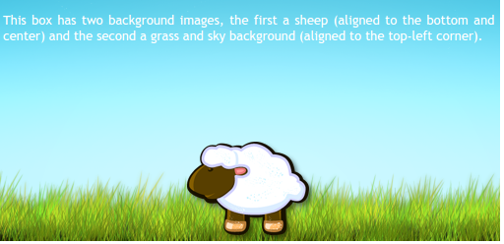
CSS 3 Backgrounds- Multiple Background Images
With CSS 3 you can use multiple background images for HTML element
#example1 {
width: 500px;
height: 250px;
background-image: url(sheep.png),
url(betweengrassandsky.png);
background-position: center bottom, left top;
background-repeat: no-repeat;
}
You can specify multiple
images here

Slide 72

CSS 3 Backgrounds- Background Size
With CSS 3 you can set the size of the background images for HTML element
#container {
border: 1px solid #000;
background-size: 100px 100px;
background-image: url(images/MacBook_Pro_13.jpg);
background-repeat: no-repeat;
height: 200px;
width: 200px;
}
Horizontal and vertical
size of the background

Slide 73
CSS 3 Backgrounds- Background Clip
With CSS 3 you can set how the background of the element stretches
Syntax:
background-clip: border-box|padding-box|content-box|initial|inherit;

Slide 74
CSS 3 Backgrounds- Background Origin
With CSS 3 you can set from where your background can start.
Syntax:
background-origin: border-box|padding-box|content-box|initial|inherit;

Slide 75

CSS 3 Linear Gradients
CSS 3 enables gradient colors for element backgrounds:
Syntax
background: linear-gradient(direction|angle, color-stop1, color-stop2, ...);
#grad1 {
height: 200px;
/* For Safari 5.1 to 6.0 */
background: -webkit-linear-gradient(red, blue);
/* For Opera 11.1 to 12.0 */
background: -o-linear-gradient(red, blue);
/* For Firefox 3.6 to 15 */
background: -moz-linear-gradient(red, blue);
/* Standard syntax (must be last) */
background: linear-gradient(red, blue);
}

Slide 76

CSS 3 Radial Gradients
Syntax
background: radial-gradient(shape size at position, start-color, ..., last-color);
#grad1 {
height: 150px;
width: 200px;
/* Safari 5.1 to 6.0 */
background: -webkit-radial-gradient(red, green, blue);
/* For Opera 11.6 to 12.0 */
background: -o-radial-gradient(red, green, blue);
/* For Firefox 3.6 to 15 */
background: -moz-radial-gradient(red, green, blue);
/* Standard syntax (must be last) */
background: radial-gradient(red, green, blue);
}

Slide 77
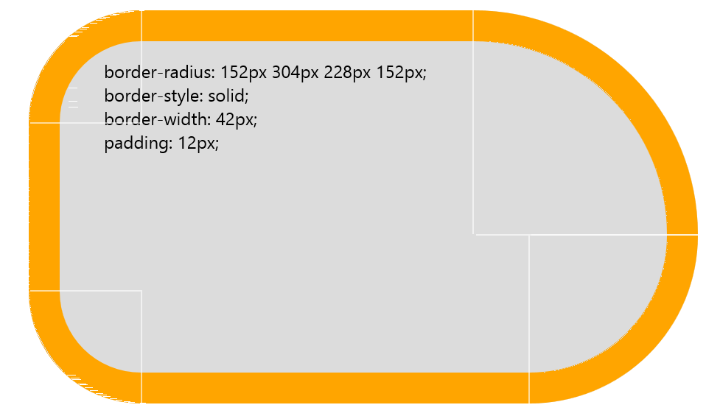
CSS 3 Borders
CSS 3 provides a way to set rounded corners to the borders of HTML elements via the border-radius CSS rule.
You can set border radius for each corner

Slide 78


CSS 3 Word Wrap
The word-wrap rule allows long words to be translated to the next row.
word-wrap: <horizontal> <vertical> <blur size> color;
.container {
width: 50px;
border: 1px solid #000;
margin-bottom: 20px;
}
<div class="container">
My super long textttttttttttttttttttttt
</div>
.container {
width: 50px;
border: 1px solid #000;
margin-bottom: 20px;
word-wrap: break-word;
}
<div class="container">
My super long textttttttttttttttttttttt
</div>

Slide 79

CSS 3 Text Shadow
text – shadow – allow us to set shadows for texts
text-shadow: <horizontal> <vertical> <blur size> color;
h1 {
text-shadow: 5px 5px 10px #000;
}
<h1>Text With Shadow</h1>

Slide 80
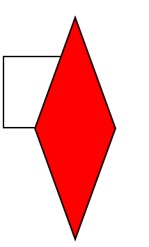
CSS 3 2D Transformation
Syntax:
transform: translate(<x>, <y>)|rotate(<deg>)|scale(<x>, <y>)|skew(<angle x>, <angle y>)
.demo {
width: 50px;
height: 50px;
border: 1px solid #000000;
background-color: red;
-webkit-transform: translate(25px, 25px) rotate(45deg)
scale(1.5, 1.5) skew(25deg, 25deg);
-moz-transform: translate(25px, 25px) rotate(45deg)
scale(1.5, 1.5) skew(25deg, 25deg);
-o-transform: translate(25px, 25px) rotate(45deg)
scale(1.5, 1.5) skew(25deg, 25deg);
transform: translate(25px, 25px) rotate(45deg)
scale(1.5, 1.5) skew(25deg, 25deg);
}

Slide 81
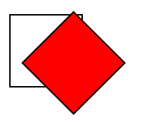
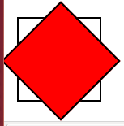
CSS 3 2D Transforms
Transform-origin – translates the origin of the transformations
Syntax:
transform-origin: <origin x> <origin y>
transform: rotate(45deg);
transform-origin: 50% 100%;
transform: rotate(45deg);

Slide 82
CSS 3 3D Transforms
DEMO
http://www.clicktorelease.com/code/css3dclouds/

Slide 83
Media queries
Media queries are blocks of CSS code which are applied on the document only on certain conditions provided by the device.
Syntax:
@media <type> and(<condition>)[.. and | or (<conditions>)] {
// CSS goes here
}

Slide 84
Responsive layouts with media queries
@media screen and (min-width : 320) {
/* smartphone code goes here */
}
Mobile first
Use relative units
Example:
@media screen and (min-width : 780) {
/* tablet code goes here */
}
@media screen and (min-width : 1024) {
/* desktop code goes here */
}

Slide 85
CSS 3 Animations
Animation and keyframes :
    Animation – defines what animation should be applied to the element
    Key frames – define what does the animation do

Slide 86
CSS 3 Animations
Defining Keyframes :
Initial value
to be set
@keyframes pulsate{
0% { width: 50px;}
50% { width: 100px;}
100% { width: 50px;}
}
Value
On the 50% of the animation
Value
On the 100% of the animation

Slide 87
CSS 3 Animations
Defining the element animation :
We set the animation
.demo {
width: 50px;
height: 50px;
background-color: red;
animation: pulsate;
animation-duration: 1s;
animation-iteration-count: infinite;
}
We set the animation
Duration.
Note the syntax!
We set how many times
animation should be repeated

Slide 88
CSS 3 Animations
Defining the element animation :
We set the animation
.demo {
width: 50px;
height: 50px;
background-color: red;
animation: pulsate;
animation-duration: 1s;
animation-iteration-count: infinite;
}
We set the animation
Duration.
Note the syntax!
We set how many times
animation should be repeated

Slide 89
CSS 3 Animations
DEMO

Slide 90
CSS 3 Multicolumn layout
We can create multicolumn layouts with CSS 3 like news papers:
    column-count – defines the number of columns
    column-gap – defines the gap between the columns
    column-rule – defines the style of the rule between the columns
http://www.w3schools.com/css/css3_multiple_columns.asp

Slide 91
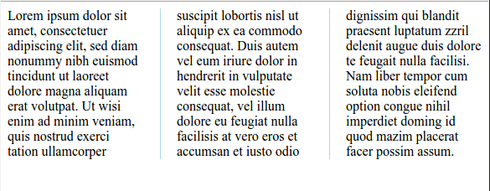
CSS 3 Multicolumn layout
.newspaper {
-webkit-column-count: 3;
/* Chrome, Safari, Opera */
-moz-column-count: 3;
/* Firefox */
Column-count: 3;
/* Chrome, Safari, Opera */
-webkit-column-gap: 40px;
/* Firefox */
-moz-column-gap: 40px;
column-gap: 40px;
/* Chrome, Safari, Opera */
-webkit-column-rule: 1px solid lightblue;
/* Firefox */
-moz-column-rule: 1px solid lightblue;
column-rule: 1px solid lightblue;
}

Slide 92
Responsive layouts
Responsive layouts are layouts which can change their look in different screens.
Most important screen types are
  Desktop – large – we can afford more columns
  Tablets – medium- max 2 columns
  Phones – small – 1 column

Slide 93
Summary
Formating text with CSS
Styling Tables
Box Model
Borders
CSS 3 – Selectors
CSS 3 – Backgrounds
CSS 3 – Gradients
CSS 3 – Borders
Transformations And Animations

